Slide 1

NetDMR Permittee and Data Provider Training

Slide 2
Webinar Details
EPA is using this webinar to present important information on NetDMR reporting.
Due to the expected large number of participants, we are muting all lines except for the lines of the EPA presenter.
Listeners can use the webinar ‘Question Box’ to send in questions or comments.
  We will be monitoring and answering questions as they come.

Slide 3
Agenda
Introduction to NetDMR
How to Create CDX Account – Permittee (signature)
How to Request Access – Signatory
Review My Account
How to Enter DMR Data
How to Import Data
How to View COR

Slide 4
Introduction to NetDMR

Slide 5
What is NetDMR? (formal answer)
National Pollutant Discharge Elimination System (NPDES) permittees required to submit Discharge Monitoring Reports (DMRs) may use NetDMR after requesting and receiving permission from their permitting authority.
After the State or Region has approved the facility’s request, the NetDMR tool enables permittees to complete their DMRs via a secure Internet connection.

Slide 6
What is NetDMR? (Key Point)
Web-based application that will allow NPDES permittees to submit DMRs electronically to EPA’s Integrated Compliance Information System (ICIS)
Hosted on Central Data Exchange (CDX) servers
Provides separate customizable “NetDMR Program Services”

Slide 7
CDX vs NetDMR – What’s the Difference?
Central Data Exchange
(CDX)
Network Discharge Monitoring Report
(NetDMR)
Agency's system for the electronic reporting and management of DMR data
Uses a "Subscriber Agreement" to authenticate and authorize users who Sign and Submit DMRs at a permit level
User must sign a Subscriber Agreement for each NPDES ID they are requesting Signatory Role for
Agency User account creation and management tool used for access several different EPA systems with a single login
Uses "Signature Agreement" to authenticate and authorize users who 'certify' data
Signature Agreement need only be submitted/approved once per CDX account

Slide 8

NetDMR as a Program Service within CDX
CDX
Access & Authentication
MSGP
SSO
NetDMR
CGP

Slide 9
Creating a new Central Data Exchange (CDX) Account

Slide 10
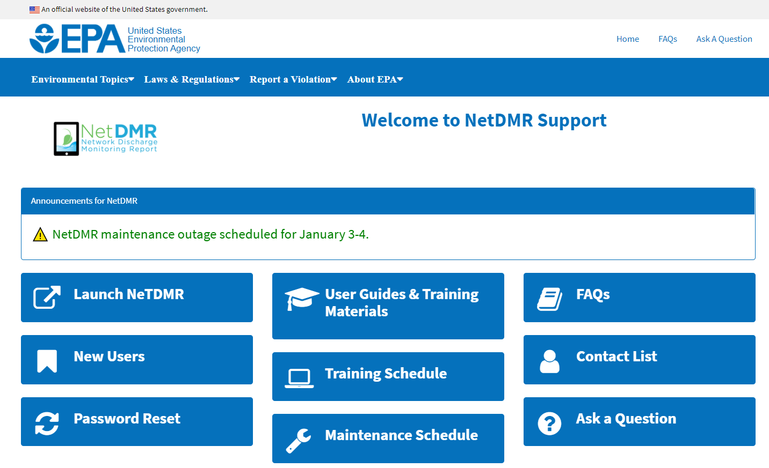
Create a New CDX Account
Go to NetDMR website: https://usepa.servicenowservices.com/oeca_icis?id=netdmr_homepage
Click on Launch NetDMR button

Slide 11
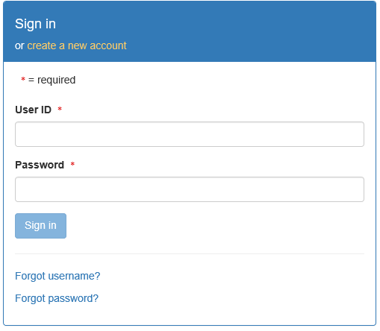

Create a New CDX Account
  Login screen appears
  Click on create a new account

Slide 12
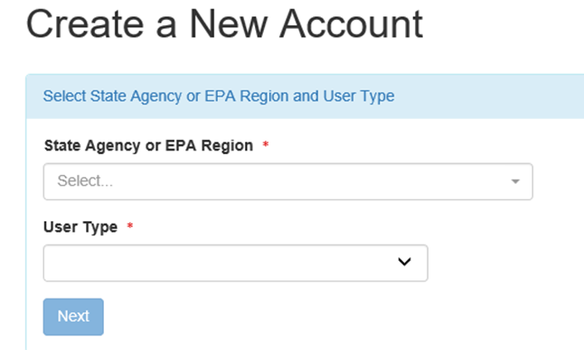
Selecting Instance and User Type
All * fields are required
Select State Agency or EPA Region (aka Instance Name) and User Type
  Regulatory Agency where your DMRs are sent
Choose your Instance from the pull-down menu

Slide 13
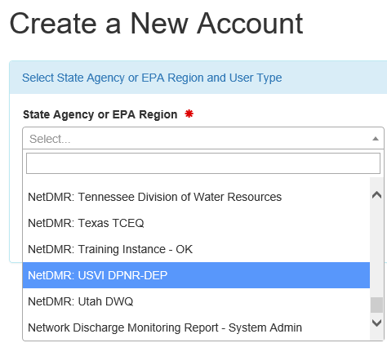
Select Instance
Select your Regulatory Authority
For example:
  Virgin Islands – DMRs are sent to state agency
    Choose USVI DPNR-DEP
  Puerto Rico facilities submit DMRs to EPA
    Choose EPA Region 2 Instance

Slide 14
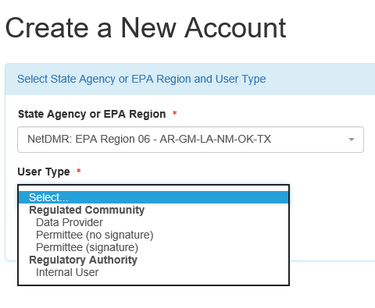
Select User Type
Select User Type
  Permittee (signature)
  Permittee (no signature)
  Data Provider
Press NEXT to continue

Slide 15
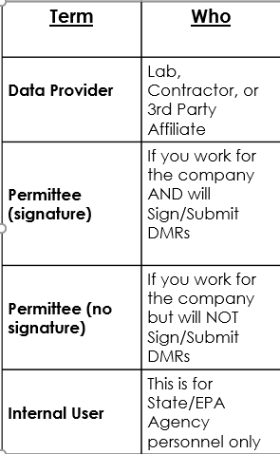
CDX User Types

Slide 16
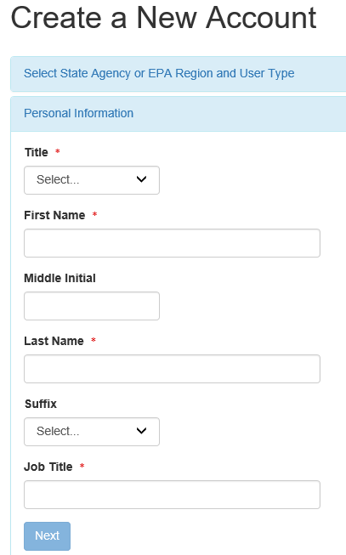
Personal Information
Fill out required information
  All boxes with asterisks *
  For Permittee (signature)
    Ensure First & Last Names are your legal names (e.g. Robert, not Bob)
  Click NEXT when done
16

Slide 17
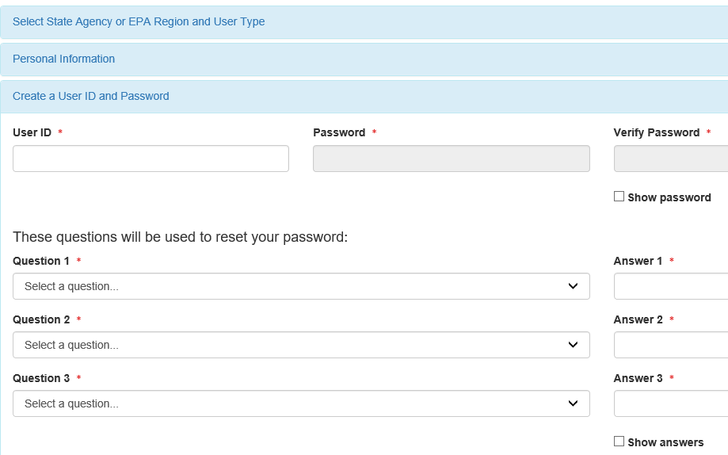

Create a User ID and Password
Create User ID & Password
Choose 3 Security questions, and enter an answer
  Case Sensitive
Agree to the Terms and Conditions
Click Next

Slide 18
Signatory Accounts
Additional steps required if requesting the CDX role of Permittee (signature)
  Required to answer 5 additional questions for digitally signing documents
  AND
  Electronic Signature Agreement (ESA) or Paper ESA is required

Slide 19
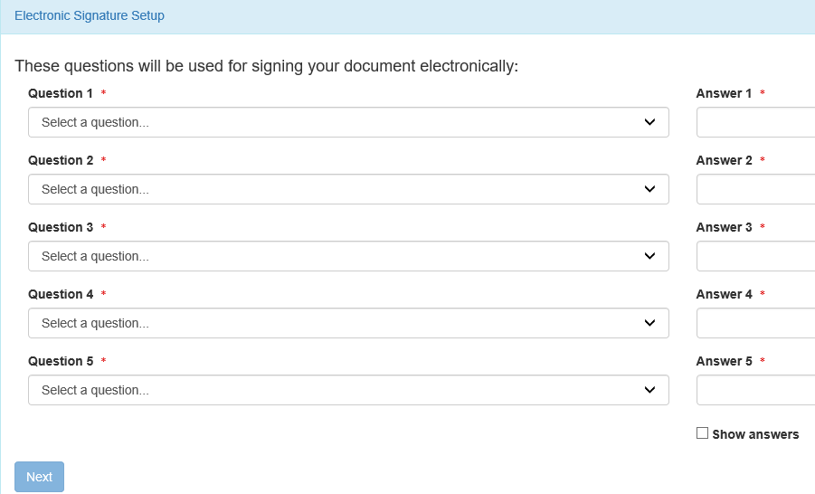
Electronic Signature Agreement (ESA) Setup –Permittee (signature) Only
Select 5 security questions from the drop-down list
Enter an answer for each question selected
Remember your answers!

Slide 20
Updating Signatory Questions (Demo)
How do I update my (5) Signatory Questions in CDX?
  https://usepa.servicenowservices.com/oeca_icis?sys_kb_id=b69f36171b940d182486eb9ce54bcbfa&id=kb_article_view&sysparm_rank=1&sysparm_tsqueryId=cd3660851b160950cb91a759bc4bcb7a

Slide 21
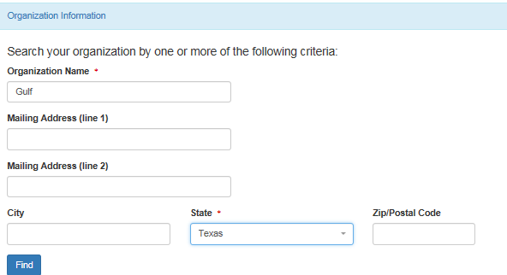
Organizational Information
Search for your organization
  Organization name and State are required
    Other search fields are optional
  This is the organization you work for (your employer)

Slide 22
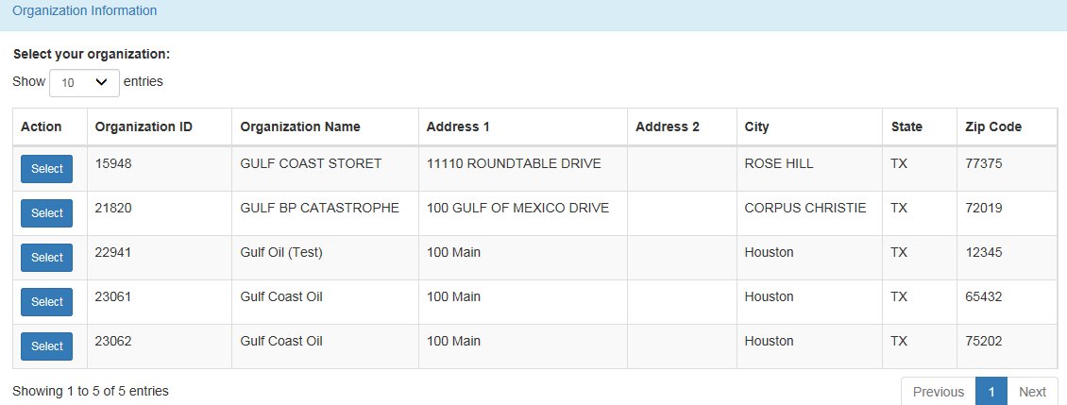
Select Organization
Click on the Select button to choose your Organization

Slide 23
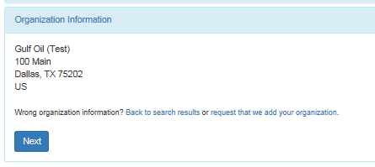
Organization
Confirm your Organization

Slide 24
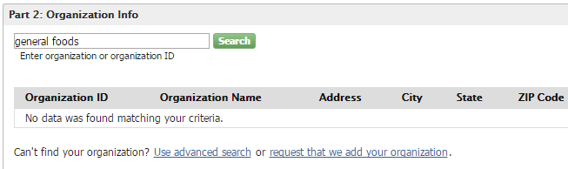
How to Add Organization
If you cannot find your organization
“Request that we add your organization”

Slide 25
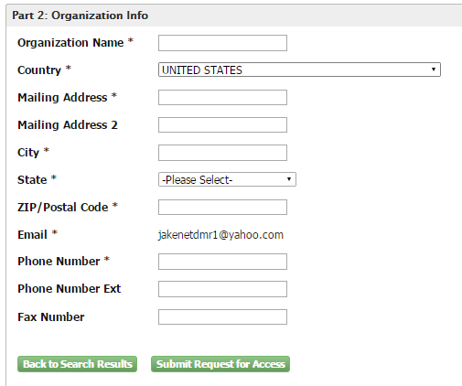
Add Organization – Continued
Fill out the required information for your organization
Click “Submit Request for Access”

Slide 26
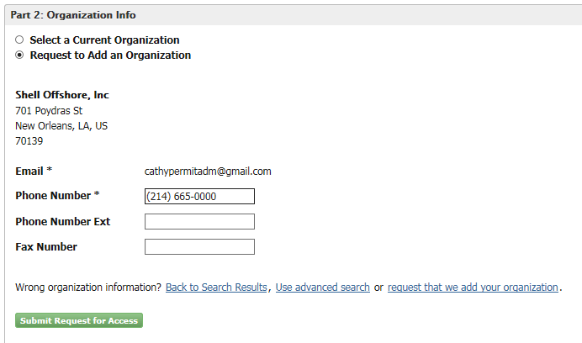
Add Organization - Continued
Select your Organization
Enter your phone number

Slide 27
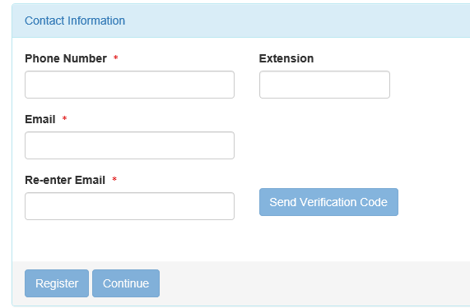
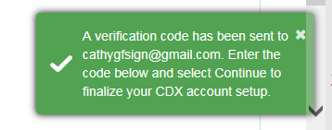
Contact Information
Enter required fields.
Click SEND VERIFICATION CODE.
A green pop-up note will appear on screen informing an email was sent to this email.
You will receive an email from CDX support with a Verification Code within a few minutes.

Slide 28
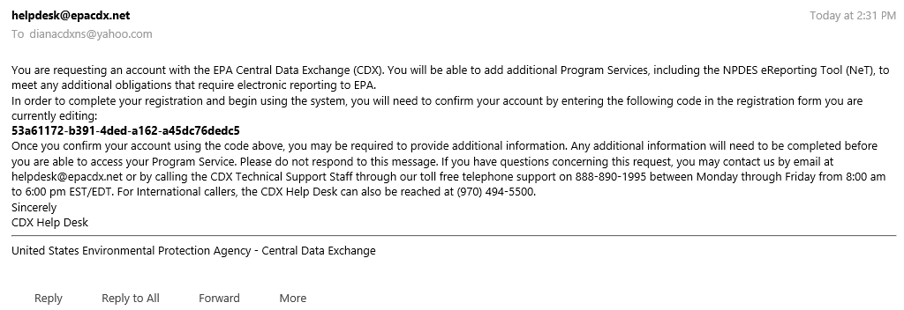
Email Verification

Slide 29
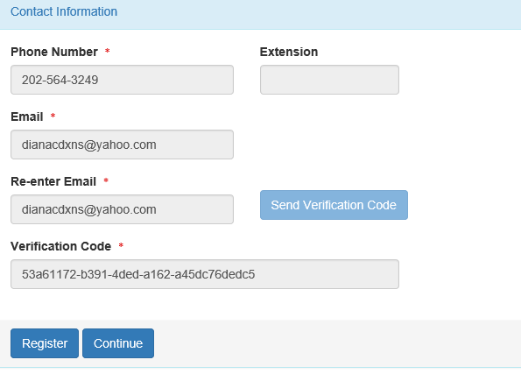
Contact Information/ Registration
After clicking SEND VERIFICATION CODE a verification box will appear
  Enter Verification Code
  You can COPY & PASTE code from email directly into box.
Click Register

Slide 30
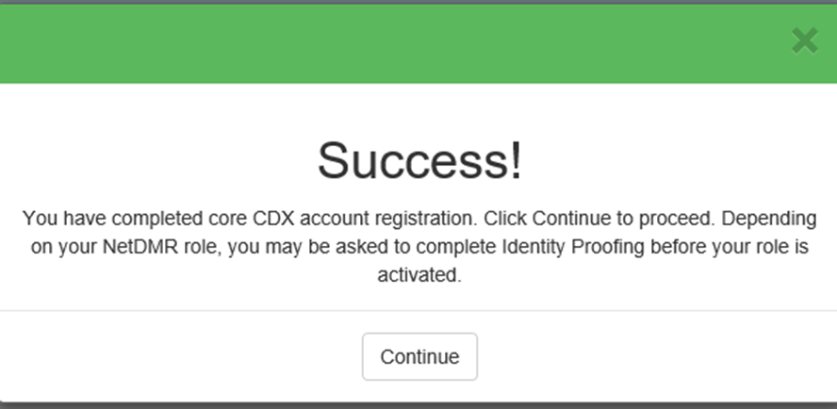
Organization Registration Completed
After clicking on REGISTER, this pop-up will appear confirming completion
Click CONTINUE

Slide 31
Registration Process
At this stage, Permittee (no signature) and Data Providers are finished and now have access to NetDMR
Permittee (signature) must continue with Identity Proofing

Slide 32
Permittee (signature) -Additional Requirements
Permittee (signature) will need to continue as additional information is required
  Identify Proofing
    Electronic Signature Agreement (ESA)
    Paper ESA option
Log into CDX

Slide 33
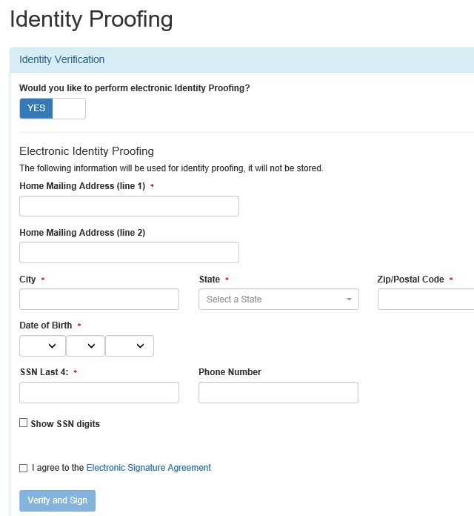
Identity Proofing
Enter required fields with an asterisk
Agree Electronic Signature Agreement (ESA)
Verify and Sign
Paper option available
  Click on white tab for paper
Click on white tab for paper option of Identity Proofing

Slide 34
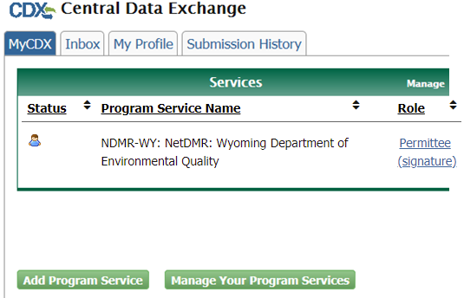
Approved ESA-
MyCDX
This is the landing page when logging into NetDMR
Clicking on your ROLE hyperlink will take you to the NetDMR homepage

Slide 35
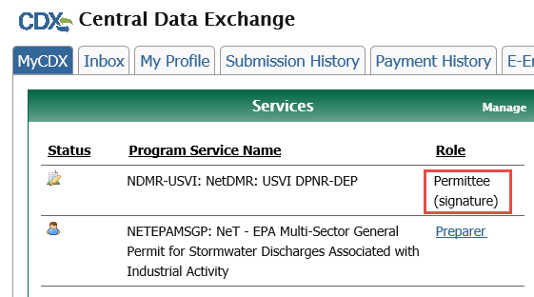
Failed Identity Proofing/Paper ESA-
MyCDX
If you failed identity proofing, you will not be able to access NetDMR
  Your role will not be clickable(not a hyperlink)
You must sign a paper ESA and submit with wet signature to your RA

Slide 36
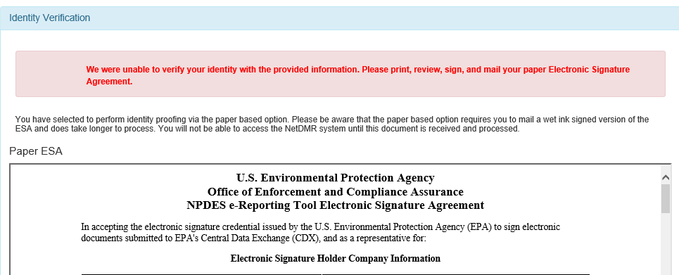
Identity Proofing- Paper ESA
If LexisNexis is unable to verify your identity – you Must Submit Paper ESA

Slide 37
Reseting CDX password (Demo)
How to reset password in CDX:
  https://usepa.servicenowservices.com/oeca_icis?sys_kb_id=1577d7da1b8601d4ea6942ecac4bcb52&id=kb_article_view&sysparm_rank=3&sysparm_tsqueryId=a3f6ac891b160950cb91a759bc4bcb60
How Do I Use My Mobile Phone To Reset My Password In CDX?
  https://usepa.servicenowservices.com/oeca_icis?sys_kb_id=058f36171b940d182486eb9ce54bcb38&id=kb_article_view&sysparm_rank=1&sysparm_tsqueryId=a217e40d1b160950cb91a759bc4bcb21

Slide 38
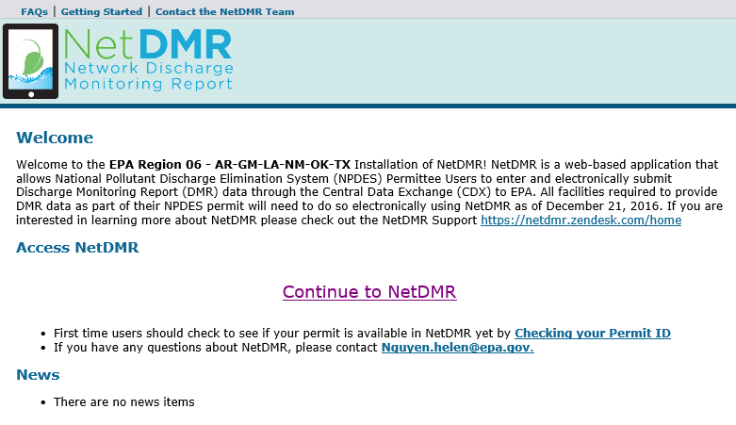
Entering NetDMR
Click on role to access NetDMR landing page
Click on ‘Continue to NetDMR’ to continue.
Will need to continue by Requesting Access to specific NPDES ID(s) within NetDMR.

Slide 39
User Types and Roles

Slide 40
User’s Types in CDX
Permittees
  Permittee (signature)
  Permittee (no signature)
Data Providers (Contractors and Labs)
Internal Users (EPA & State Regulatory Authority)

Slide 41
User’s Roles in NetDMR
Permit Administrator
  Permittee (signature) OR
  Permittee (no signature)
Signatory
  MUST be Permittee (signature)
Edit
  ALL users
View
  ALL users

Slide 42
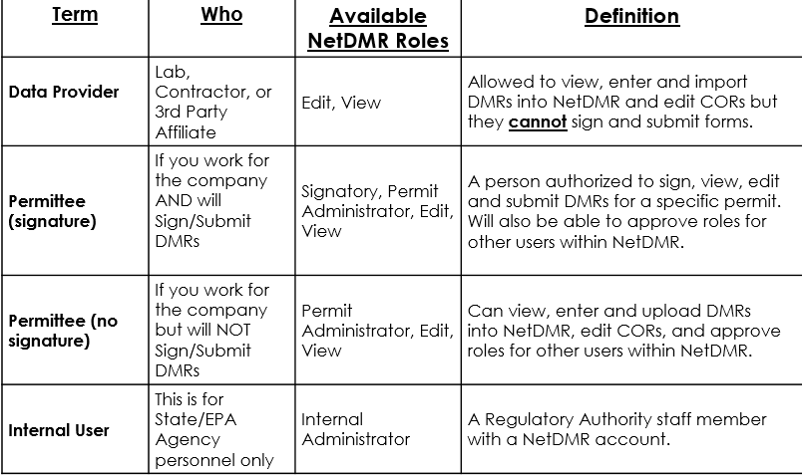
How Types and Roles are related

Slide 43
Signatory Role
(Permittee (signature) User)
You will be able to:
  Sign and submit the Subscriber Agreement
  View, edit, import, sign and delete DMRs
  Submit corrected DMRs – generate CORs
  Initiate the repudiation of unauthorized DMRs
Note: ALL Signatory role automatically get Permit Administrator role

Slide 44
Permit Administrator Role
Manage Access for their NPDES permit(s)
  Permit Administrator
  Edit
  View (DMRs and CORs)
  Approve Regulatory personnel requesting view partial DMRs
To edit, import, refresh, and delete DMRs
  Request “Signatory” or “Edit” role
To Sign DMRs
  Request “Signatory” role

Slide 45
Preparing for NetDMR

Slide 46
First Steps
Determine who will be your initial Signatory with Permit Administrator role
  This person should log on first
    Create account, finalize account, request access
    Verify that Regulatory Agency approved
Identify others at your facility that would need the Edit, Permit Administrator, View or Signatory role(s)
  Other users will have to wait to request access after 1st Signatory is approved

Slide 47
First Permit ID Request
Initial Signatory request from your facility
  Will have Signatory and Permit Administrator roles automatically
Others at your company can apply for one or more roles
  Signatory, Permit Administrator role, Edit, or View role
    (After Initial Signatory is approved)
    Permit Administrators can grant access for anyone with Permit Administrator, Edit or View roles

Slide 48

NetDMR
Some of the Basics

Slide 49
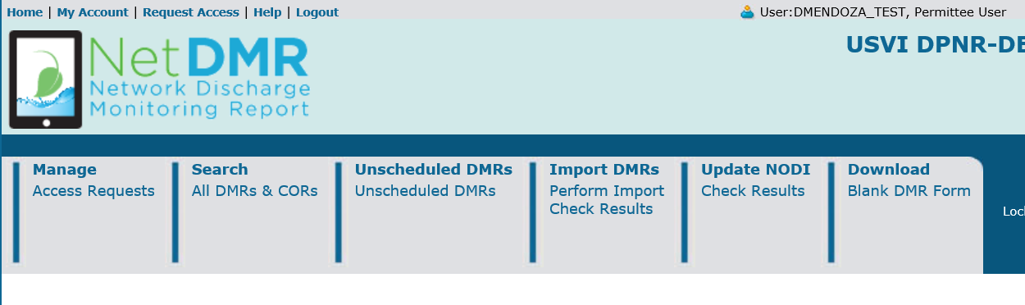
Header Options

Slide 50
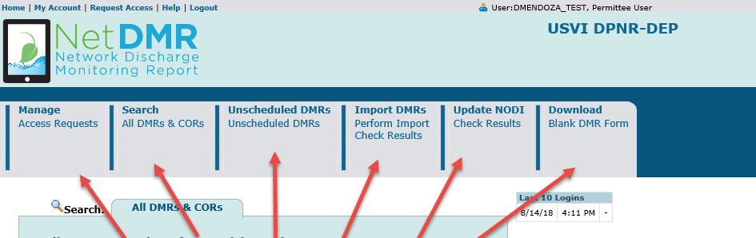
Tabs
Several Options
(depending on your User Type and Roles)

Slide 51
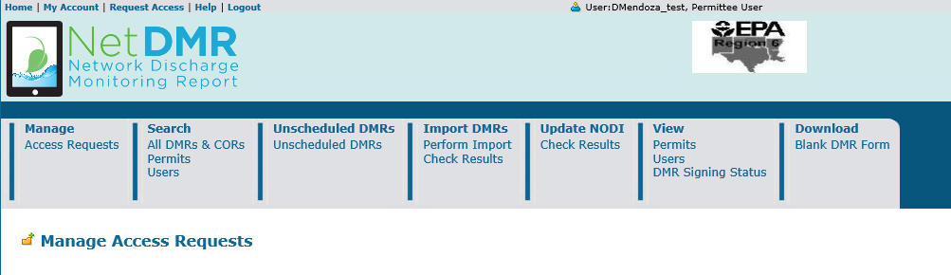
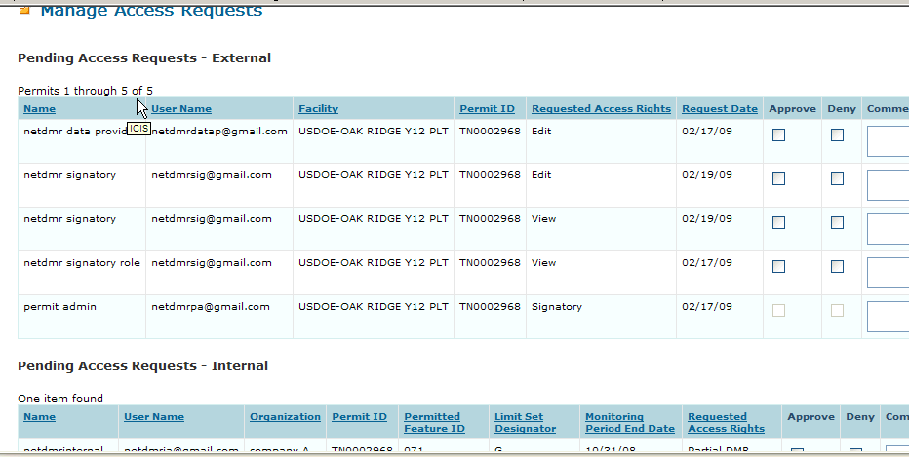
Manage Access Requests

Slide 52
Search
Permits
Copy of Records (COR)
List of Users
DMRs to edit, correct or delete
DMRs Ready to submit
Detailed instructions are contained in the Permittee/ Data Provider User Guide

Slide 53
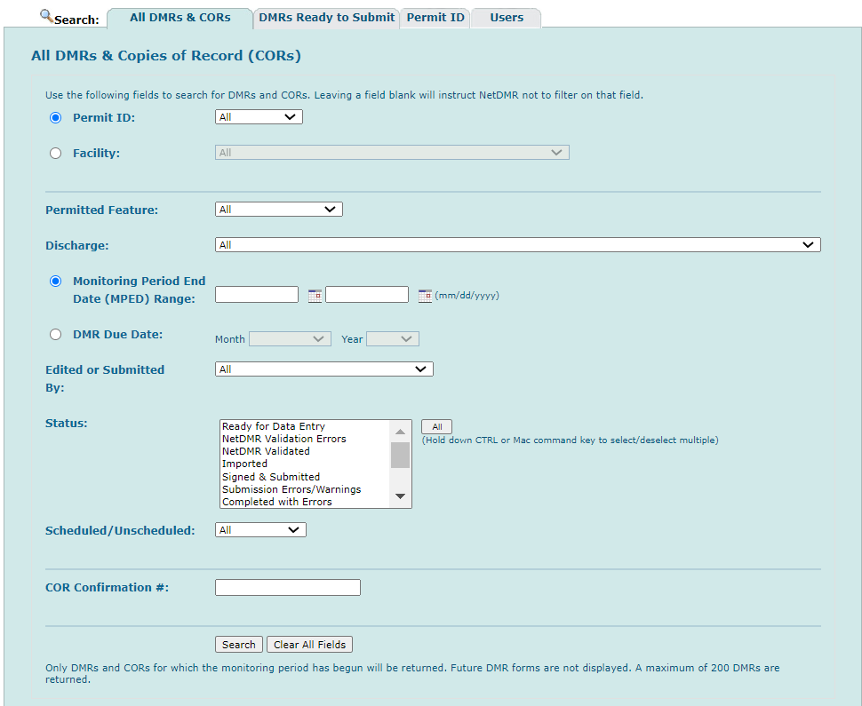
DMR Search & Status

Slide 54
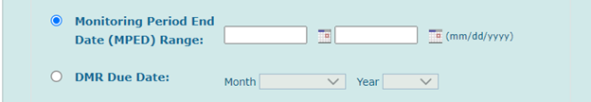
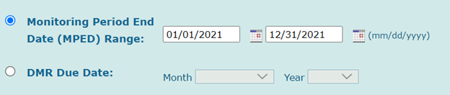
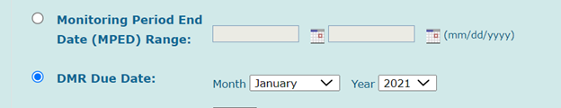
Follow
How To Search The DMR With DMR Due Date?
DMR Search
From the All DMR’s and Copies of Record (CORs), pick your Permit ID number from the drop down. The Monitoring Period End Date (MPED) Range and DMR Due Date have Radio buttons. Then select either the MPED range or DMR Due Date, or no dates at all. If data are entered for one option, and then the user selects the other radio button, the data for the first option should be blanked out.
When MPED Range button selected, then user should add the start and end date of monitoring. For example: User wants to see all the DMRs started from 01/01/2021 and ended at 12/31/2021.
When DMR Due Date button selected, then user can select Month and Year. For example: User wants to see all the DMRs due in January of 2021.
Please notice the MPED Range is gray out since DMR Due Date button was selected.
NOTE: Only DMRs and CORs for which the monitoring period has begun will be returned. Future DMR forms are not displayed. Only a maximum of 200 DMRs are returned.

Slide 55
Requesting Access
(For Permit Administrator, Edit, or View Roles)
Live Demo

Slide 56
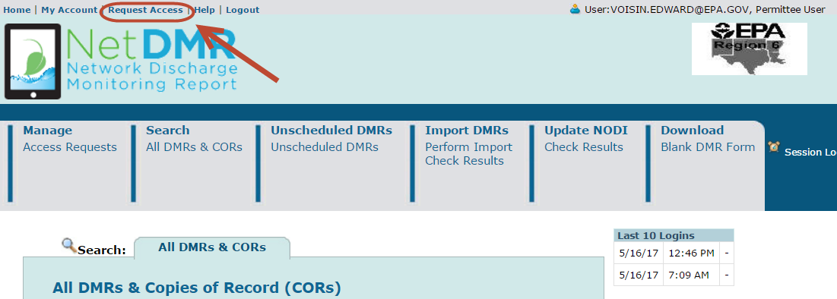

Request Access

Slide 57
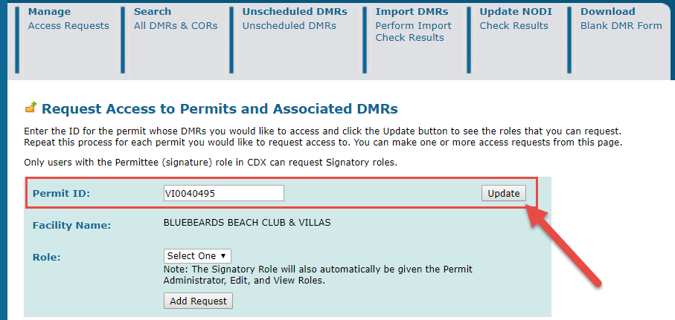
Enter Permit ID (Click Update)

Slide 58
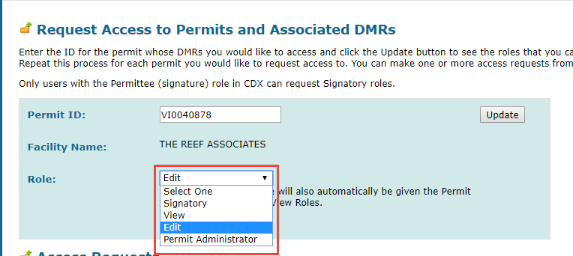
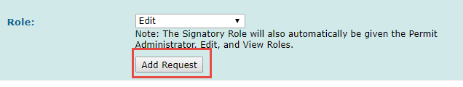
Select Role

Slide 59
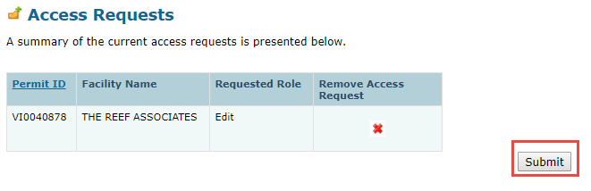
Submit Request

Slide 60
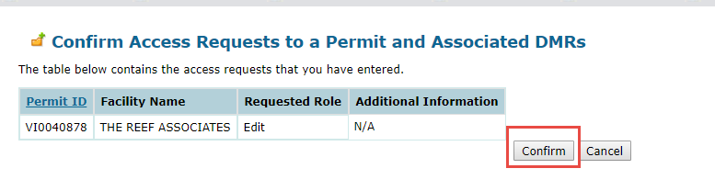
Confirm Request

Slide 61
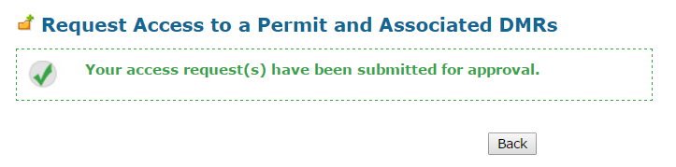
Approval
61
Wait for your Permit Administrator to approve you

Slide 62
How to Request a Signatory Role

Slide 63
RO or DAR? (Signatories Only)
Are you a Responsible Official (RO) or a Duly Authorized Representative (DAR)?
Responsible Officials are authorized to sign and submit DMRs themselves (in accordance with 40 CFR 122.22)
Duly Authorized Representatives are authorized to sign and submit DMRs on behalf of a Responsible Official
  When Requesting Access as a Signatory, DARs will need to enter the Responsible Official Information to complete the Subscriber Agreement

Slide 64
Signatory Access Role
(Responsible Official)
Live Demo

Slide 65
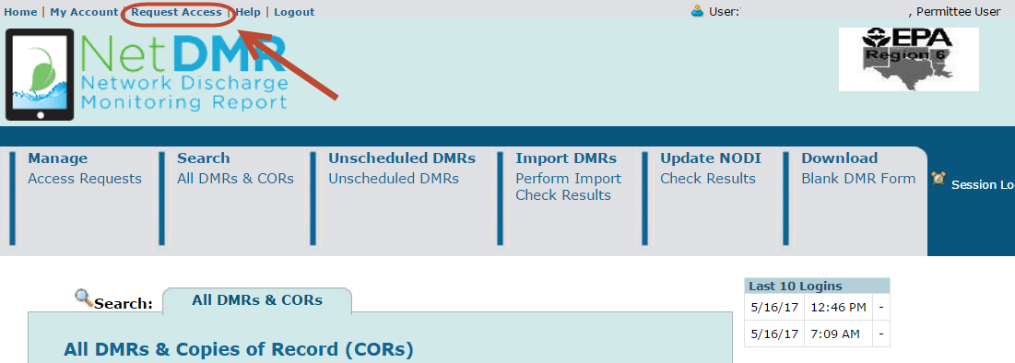
To get Request Access
Click on “Request Access” to type in the permit you want to have Signatory access to

Slide 66
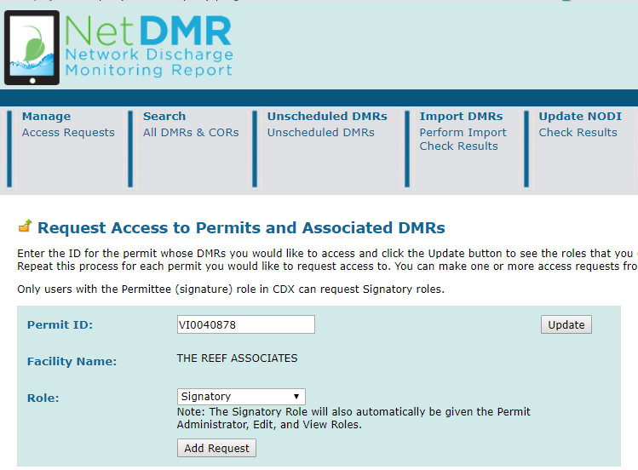
Insert Permit ID and Role
Type in Permit ID
Click “Update”
Next, click on drop-down list
Click “Signatory”
Click “Add Request”

Slide 67
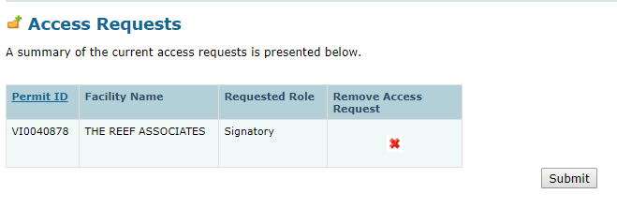
Submit Request
Make sure you typed in the correct Permit ID and Role
If correct, click Submit

Slide 68
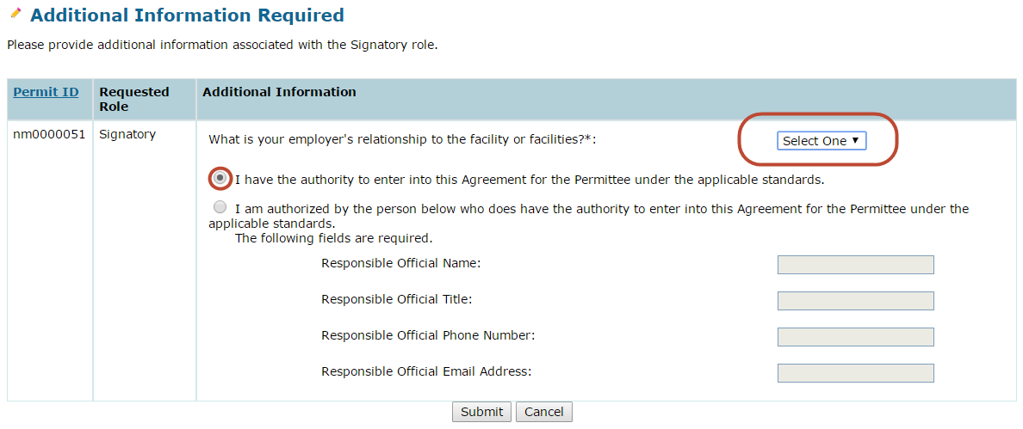
Select Radio Button for Responsible Official
Click on employer's relationship to facility
Click on first radio button if you are the RO

Slide 69
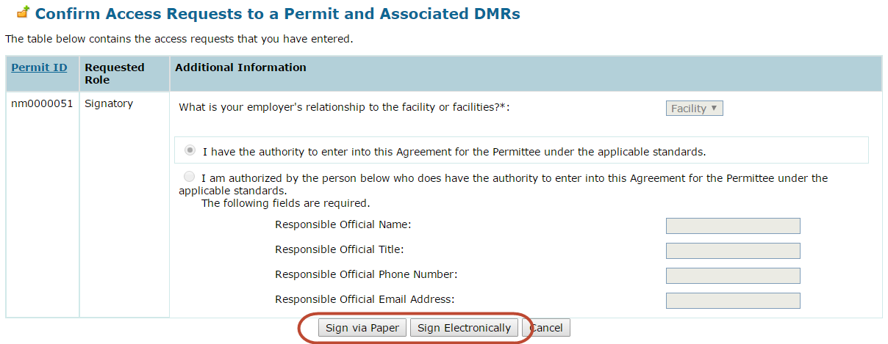
Paper or Electronic Signature
Click either sign electronically or sign via paper

Slide 70
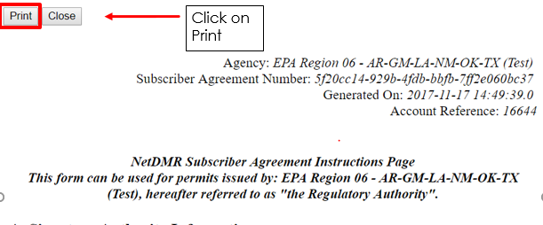
Paper Signature
A pop-up window with your SA will appear
Click on print

Slide 71
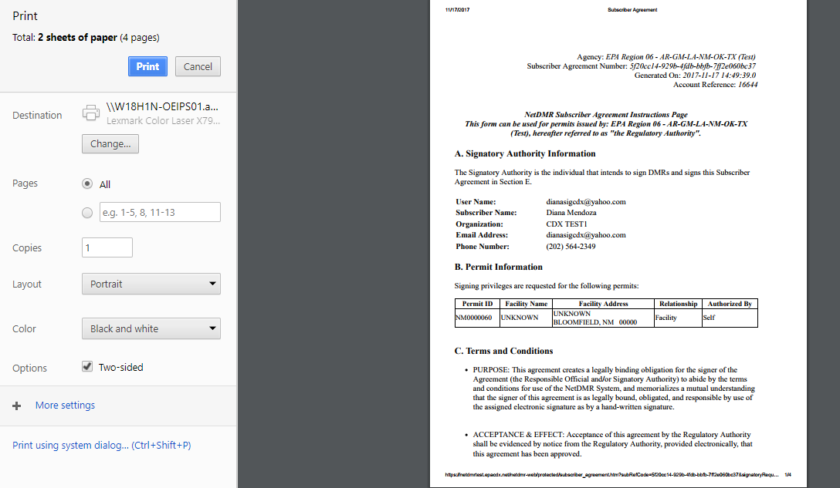
Paper ESA
(IE)

Slide 72
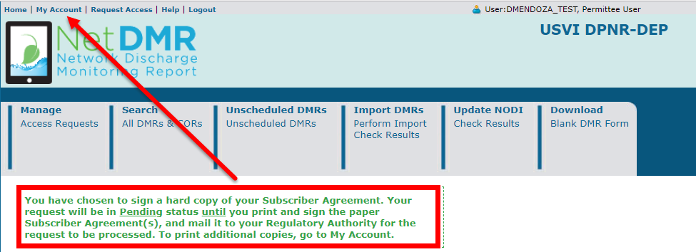
Paper Signature
Upon clicking “Sign via Paper” you will receive a message stating you will have to go to My Account to print paper SA

Slide 73
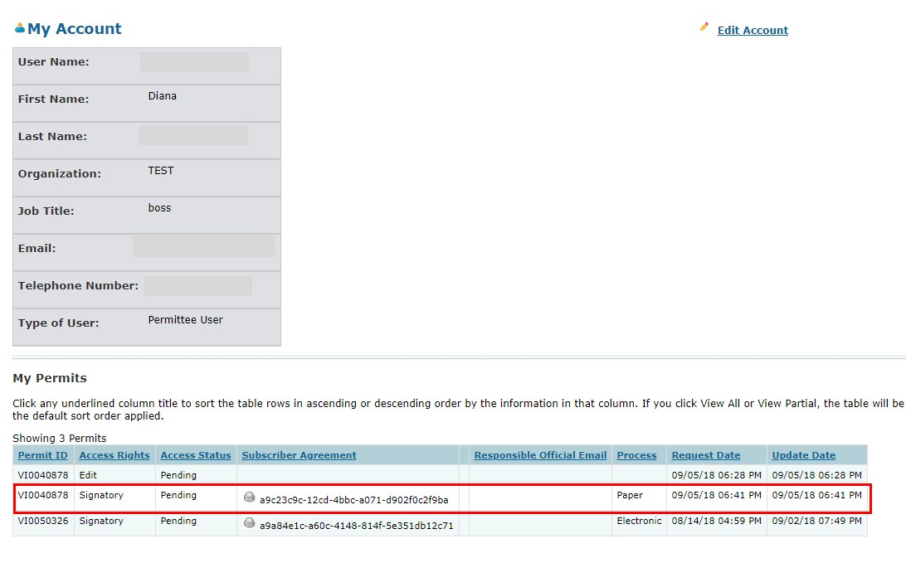
Paper Signature
To print SA, click on printer icon

Slide 74
Paper Signature
A pop-up window with your SA will appear
Click on print

Slide 75
Final Print

Slide 76

Where to mail Subscriber Agreement
Once signed, mail Subscriber Agreement (SA) to your Regulatory Authority (RA)
  You can find your RA’s mailing information on the bottom of SA form

Slide 77
Approving/ Denying Paper Subscriber Agreement
RA accesses NetDMR to approve/deny pending Signatory access role
Note: Paper process can take several weeks to complete

Slide 78

Electronical Signature
Upon clicking on “Sign Electronically”, a pop-up box will appear confirming you have chosen to sign your Subscriber Agreement electronically
As an RO, your request will be sent directly to your RA via email
Click on Sign Electronically to sign SA

Slide 79

Electronical Signature
Complete the following steps for authorization:
  Enter password to start authenticate eSignature process.
  Answer security question
  Click on “Sign”

Slide 80

Route to RA
After signing SA, a message will appear confirming your electronical signature

Slide 81
Signatory Access Role
(Duly Authorized Representatives)

Slide 82
Prerequisites
User must be User Type: Permittee (signature).
DAR MUST first consult with RO to determine if RO will sign Subscriber Agreement via electronic process or paper process.
  If RO will sign electronically, RO will be required to create a CDX account.
  If RO does not want to create a CDX account, RO must sign paper Subscriber Agreement, which forces the DAR to submit paper Subscriber Agreement.
Signatory must be first person to request access to a Permit ID.
  Regulatory Authority must approve all Signatory requests.

Slide 83
Signatory Access Role
(Duly Authorized Representatives)
Live Demo

Slide 84
To get Request Access
Click on “Request Access” to type in the permit you want to have Signatory access to

Slide 85
Insert Permit ID and Role
Type in Permit ID
Click “Update”
Next, click on drop-down list
Click “Signatory”
Click “Add Request”

Slide 86
Submit Request
Make sure you typed in the correct Permit ID and Role
If correct, click Submit

Slide 87

Enter Responsible Official Information
Click on employer's relationship to facility
Click on second radio button if you are the DAR
Make sure to type in your RO's email address correctly

Slide 88
Paper or Electronic Signature
Click either sign electronically or sign via paper

Slide 89
Paper or Electronic Signature
Remember, this determination( to sign via paper of electronically) is made in consultation with your RO.
  If RO requires paper, DAR must choose Sign via Paper.
  If RO requires electronic, DAR must choose Sign Electronically.

Slide 90
Paper Signature
Upon clicking “Sign via Paper” you will receive a message stating you will have to go to My Account to print paper SA

Slide 91
Paper Signature
To print SA, click on printer icon

Slide 92
Paper Signature
A pop-up window with your SA will appear.
Click on print.

Slide 93
Final Print

Slide 94
Where to mail SA
  As a Duly Authorized Representative, your Responsible Official must sign your request before it is sent to the Regulatory Authority.
  You can find your RA’s mailing information on the bottom of SA form.
  Your status will be Pending until your request is approved by the Regulatory Authority.

Slide 95
Approving/ Denying Paper Subscriber Agreement
RA accesses NetDMR to approve/deny pending Signatory access role.
Note: Paper process can take several weeks to complete.

Slide 96
Electronic Subscriber Agreement
For DAR to submit the Subscriber Agreement electronically, the Responsible Official (RO) must have a CDX account and access to the NetDMR Program Service.
If RO chooses to submit Paper Subscriber Agreement, DAR must also sign paper. Paper and Electronic process cannot be mixed.
Electronic submission of Subscriber Agreement is much faster than paper. It can take only a few minutes to complete

Slide 97

Electronical Signature
Upon clicking on “Sign Electronically”, a pop-up box will appear confirming you have chosen to sign your Subscriber Agreement electronically.
Click on Sign Electronically to sign SA.
Note: As a DAR, your RO must have access to NetDMR to approve request before it is sent to RA.

Slide 98
Electronical Signature
Complete the following steps for authorization:
  Enter password to start authenticate eSignature process.
  Answer security question
  Click on “Sign”

Slide 99
Route to RA
After signing SA, a message will appear confirming your electronical signature.

Slide 100

Initial Request

Slide 101

Request Approved

Slide 102
DMR Data Entry

Slide 103
Entering DMRs
Direct Data Entry
Import comma delimited file from spreadsheets
Edit/Correct DMRs
Delete DMRs
Detailed instructions are contained in the Permittee/ Data Provider User Guide

Slide 104
To Stream: https://attendee.gotowebinar.com/recording/7160705131666025474
Video Demo: Finding DMRs Ready for Data Entry:

Slide 105

DMR Errors
Indicated on DMR with pink hue and exclamation mark

Slide 106

DMR Errors (Hard, Soft)
Hard Error – Must be resolved before signing DMR
Soft Error – Must be ‘Acknowledged’ (or resolved) before signing DMR

Slide 107

Sign DMRs
NOTE: Blank DMRs cannot be signed

Slide 108

Signature DMRs (cont.)

Slide 109

Signature DMRs (cont.)
Enter security question

Slide 110

Sign DMRs (cont.)

Slide 111

Sign DMRs (cont.)

Slide 112

Downloading
Copy of Record (COR)

Slide 113

Sample of COR
Click
Dl COR-Zip file
Click open
CORs

Slide 114
DMR Status

Slide 115
Signing Status
There are 4 signing status values:
SIGNED_SUCCESSFULLY – Signing process completed
SIGNING_FAILED – Signing process failed
PROCESSING – In the process of being signed at CDX
PENDING – In the queue to be sent to CDX for signing
The only values users should expect to see are the first 4: SIGNED_SUCCESSFULLY, SIGNING_FAILED, PROCESSING, PENDING.

Slide 116
DMR Submission email – COR Submission Received
After DMR signed & submitted, from netdmr-notification@epacdx.net,
user receives two DMR submission emails
1- First email:
  From: <netdmr-notification-test@epacdx.net>
  Date: Tue, Aug 21, 2018 at 10:20 AM
  Subject: COR Submission Received for: VI0000019
    NetDMR has sent the following 1 DMR(s) to be signed.
    CORs have been created for the following DMRs. These DMRs will be forwarded for further processing:
    --------------------------------------------
    Permitted Facility Name: HOVENSA LLC
    Permit ID: VI0000019
    Permitted Feature: 001
    Discharge: A - Composed of Wastewater from the lagoon systems.
    Monitoring Period End Date: 08/31/18
    Signing Status: SIGNED SUCCESSFULLY
    Comment:
    Attachments included in the COR: No

Slide 117

DMR Submission email - DMR(s) Submittal Passed/Warning/Failed

Slide 118
Subject: Action Required: Re-Sign and Submit
There are 3 scenarios when a Sign and Submit will “FAILED” and the DMR is not successfully signed and submitted

Slide 119
Scenario 1
Additional Data exists in ICIS that is not on the signed NetDMR DMR form. If this was not in place, a user could sign and submit a DMR form and still receive violations because the user did not know that ICIS was expecting additional DMR data.
The following email is received and the user is instructed to edit the DMR again which will pull in the new data from ICIS onto the NetDMR DMR form.
When this email is received, the status of the DMR form in NetDMR is set to “DMR Validation Errors”. When they user edits the form, a web service call is made and all of the new data from ICIS is pulled onto the NetDMR DMR form. The user will add the new missing DMR values and re-sign and submit the form.
From: netdmr-notification@epa.gov
Sent: Tuesday, June 19, 2018 2:16 PM
To: xxxxxx@gmail.com
Subject: Action Required: Re-Sign and Submit the Following DMR(s) for: NCXDMR001
NetDMR has sent the following 1 DMR(s) to be signed.
An error occurred during the signing of the following DMR(s). As a result, your submission was not successfully submitted and a Copy of Record (COR) was not created for this transaction. Please login to NetDMR, select the following DMR(s), and follow the instructions below to re-sign and successfully submit the DMR(s) as soon as possible:
--------------------------------------------
Permitted Facility Name: FAC SITE
Permit ID: NCXDMR001
Permitted Feature: 001
Discharge: B - (no description)
Monitoring Period End Date: 01/31/18
Signing Status: FAILED
Comment: Error: The DMR was not successfully signed and submitted. Please login to NetDMR, search for the failed DMR, edit the DMR, correct the data issues, click save and re-sign. Once you successfully re-sign and submit your DMR, you should receive two emails from netdmr-notification@epa.gov stating that the DMR was received and submitted successfully.
Attachments included in the COR: No
CORs have been created for the following DMRs. These DMRs will be forwarded for further processing:

Slide 120
Scenario 2
A system error occurred and CDX or Web Services could not be reached during the signing.
The user is instructed to re-sign the DMR again. When this email is received, the status of the DMR remains at “DMR Validated” and is ready to be re-signed by the user.
From: netdmr-notification@epa.goc
Sent: Monday, June 18, 2018 2:46 PM
To: darpermittee@gmail.com;
Subject: Action Required: Re-Sign and Submit the Following DMR(s) for: NCXDMR00
NetDMR has sent the following 1 DMR(s) to be signed.
An error occurred during the signing of the following DMR(s). As a result, your submission was not successfully submitted and a Copy of Record (COR) was not created for this transaction. Please login to NetDMR, select the following DMR(s), and follow the instructions below to re-sign and successfully submit the DMR(s) as soon as possible:
--------------------------------------------
Permitted Facility Name: FAC SITE
Permit ID: NCXDMR001
Permitted Feature: 001
Discharge: A - (no description)
Monitoring Period End Date: 01/31/18
Signing Status: FAILED
Comment: Error: The DMR was not successfully signed and submitted. Please login to NetDMR, search for the failed DMR and re-sign. Once you successfully re-sign and submit your DMR, you should receive two emails from netdmr-notification@epa.gov stating that the DMR was received and submitted successfully.
Attachments included in the COR: Yes
18MegaBytes6.zip
CORs have been created for the following DMRs. These DMRs will be forwarded for further processing:

Slide 121
Scenario 3
A system error occurred where the COR could not be located during a sign and submit:
The user is instructed to re-sign the DMR again. When this email is received, the status of the DMR remains at “DMR Validated” and is ready to be re-signed by the user.
The user is instructed to re-sign the DMR again. When this email is received, the status of the DMR remains at “DMR Validated” and is ready to be re-signed by the user.
From: netdmr-notification@epa.gov
Sent: Tuesday, March 13, 2018 11:08 AM
To: darpermittee@gmail.com;
Subject: Action Required: Resign and Submit the Following DMR(s) for: NCSDMR001
NetDMR has sent the following 1 DMR(s) to be signed.
An error occurred during the signing of the following DMR(s). As a result, your submission was not successfully submitted and a Copy of Record (COR) was not created for this transaction. Please login to NetDMR, select the following DMR(s), and follow the instructions below to re-sign and successfully submit the DMR(s) as soon as possible:
--------------------------------------------
Permitted Facility Name: FAC SITE
Permit ID: NCSDMR001
Permitted Feature: 001
Discharge: A - (no description)
Monitoring Period End Date: 06/30/17
Signing Status: FAILED
Comment: Error: Your signature failed. The Copy of Record was not created for this transaction. Please login to NetDMR, search for the failed DMR and re-sign. Once you successfully re-sign and submit your DMR, you should receive two emails from netdmr-notification@epa.gov stating that the DMR was received and submitted successfully.
Attachments included in the COR: Yes
CORs have been created for the following DMRs. These DMRs will be forwarded for further processing

Slide 122
Notice of Non-Receipt for Report Required by your Permit – Overdue DMRs by 7,14, 21 days

Slide 123
NODI

Slide 124
No Discharge
Even if you have no discharge, you will still need to submit DMR stating there is no discharge with a No Data Indicator (NODI) or else risk designation of Significant Noncompliance (SNC) of every quarter until submitted.
SNC will reflect noncompliance in ECHO until otherwise corrected.

Slide 125

Active NODI Codes

Slide 126

Inactive NODI Codes

Slide 127

Update NODI

Slide 128

Update NODI

Slide 129
Import DMRs

Slide 130
Importing Files
Import Files allowed for:
  New data
  Partially entered data (in progress)
  DMR Corrections

Slide 131
Roles for Importing
Signatory
  Import file
  Sign DMR
Edit
  Import file

Slide 132
Import DMR File Processing
Two people Importing at the same time or if you make small revision and submitted a file 2 times…. let the first one finish before submitting the 2nd file

Slide 133
Video Demo: How to Import DMRs:
  ServiceNow link: https://usepa.servicenowservices.com/oeca_icis?id=kb_article_view&sys_kb_id=ddfb60851b960950cb91a759bc4bcb53&spa=1

Slide 134
Resources

Slide 135
Where do I find out more about NetDMR?
New ServiceNow URL:
  https://usepa.servicenowservices.com/oeca_icis?id=netdmr_homepage

Slide 136
Users Support Contact Information:
EPA (NPDES eReporting) Helpdesk (recommended)
  Email: NPDESeReporting@epa.gov
  Phone: 1-877-227-8965
  Issues with CDX and NetDMR: Creating account in CDX, changing email address/Organization only, requesting access to permit (DAR/RO), submitting DMRs
CDX Help Desk
  Email: helpdesk@epacdx.net
  Phone: 888-890-1995
  ONLY If user’s require name change (first and last)

